Slide 1


EXPLORATORY DATA ANALYSIS FOR ICC T20 WORLD CUP 2021
Get ready for the ultimate guide to understanding the ins and outs of ICC Cricket World Cup 2021 through exploratory data analysis.

Slide 2
NAHOLI SARKAR
DIBYOJIT GHOSHAL
SOHAM PATRA
TUSHAR DAS
(Team Leader)
SUCHETANA GHOSH

Slide 3

OVERVIEW OF ICC T20 CRICKET WORLD CUP 2021
ICC T20 Cricket World Cup
The ICC Cricket World Cup is the premier international championship in men's One-Day International (ODI) cricket.
Host Country
The 2021 World Cup will be hosted by India for the first time since 2011.
Participating Teams
A total of 12 teams will participate in the tournament.

Slide 4




IMPORTANCE OF EXPLORATORY DATA ANALYSIS
Understanding the Data
Hypothesis Testing
Reducing Bias
EDA also enables hypotheses creation and testing so that we can validate or disprove our assumptions.
EDA ensures we correctly transform or drop outliers, minimize errors, and avoid biases in our conclusions.
EDA helps reveal patterns, relationships, and inconsistencies in the data which lays a foundation for further analysis.

Slide 5

DATA COLLECTION AND DATA CLEANING
1
Sources of Data
Data for the ICC Cricket World Cup 2021 is collected from Kaggle which consists of various features like best batter, best bowler, target, Winner etc. Out of which we select the performance of the best match based on the highest target achieved by the team against the other team
2
Data Pre-processing and data cleaning Techniques
We filtered the whole data based on the teams who has scored the highest target and found out the respective performance statistics for four countries namely India , Namibia, and Afghanistan. From the raw data we have extracted out the Essential features of the teams such as which batter has scored the most runs, what is the strike rate of the best batter, which bowler has scored the most wickets, etc. important decisions are featured from these kind of analysis.

Slide 6

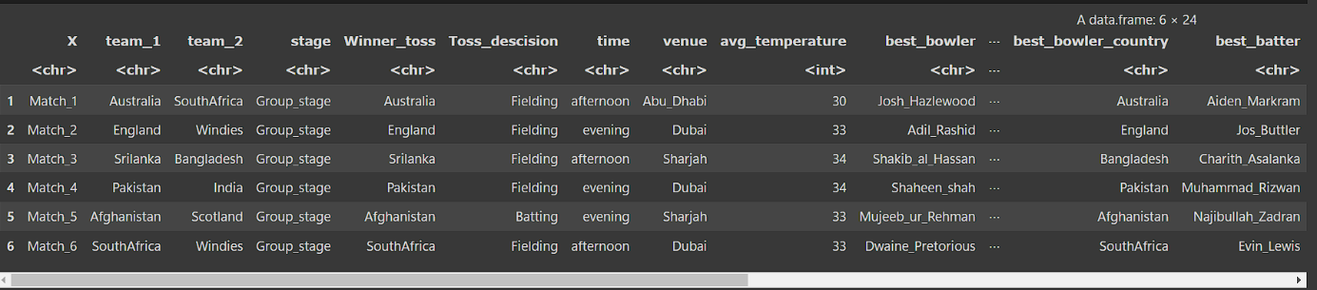
DATASET USED

Slide 7

EXPLORATORY DATA ANALYSIS
We performed the filtering and extraction on the given dataset and found out the necessary relevant information's and a visualization report based on the analysis:-
We found which teams has scored the highest target against it's opponent team and based on that we selected the following features:-
We found out the best bowler and best batter in India, Namibia & Afghanistan found out their maximum runs and wickets scored and taken.
We found out the highest strike rate and the best economy rate by the best batsman and the bower of the teams.
We found out the which team has won the toss and what is the decision of the winning team in toss.
We found out the player of the match and winner of each team
We found out how many matches were won by the same team against its other components.

Slide 8

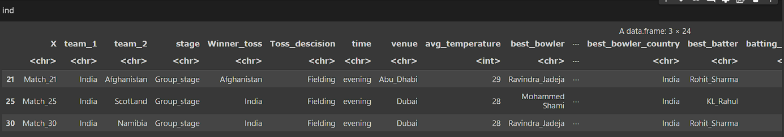
FILTERED DATASET USED

Slide 9

SUMMARY STATISTICS FOR THE ABOVE DATASET
High Indv. Scores:-
Economy:-
Most Indv. Wickets:-
Strike Rate:-
Min- 24
Min- 0.900
Min- 1.00
Min- 97.06
2. 1st Quartile- 45
2. 1st Quartile- 4.00
2. 1st Quartile- 2.00
2. 1st Quartile- 136.36
3. Median- 65
3. Median- 4.800
3. Median- 3.00
3. Median- 153.19
4. Mean- 62.39
4. Mean- 5.216
4. Mean- 2.879
4. Mean- 152.40
5. 3rd Qu- 79.00
5. 3rd Qu- 6.250
5. 3rd Qu- 3.00
5. 3rd Qu- 162.90
6. Max- 101.00
6. Max- 12.00
6. Max- 5.00
6. Max- 263.16

Slide 10
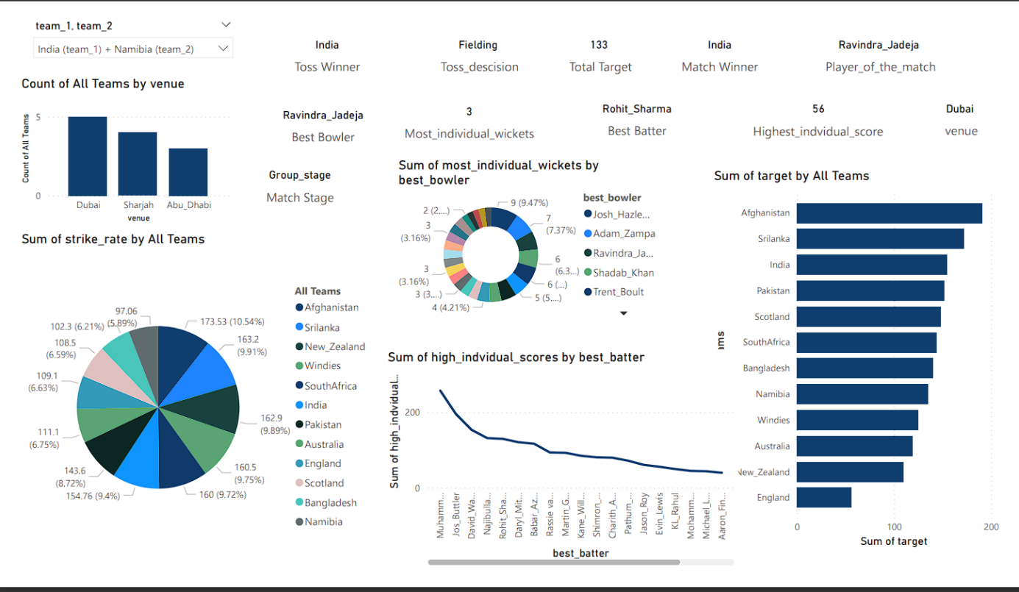
VISUALIZATION REPORT OF THE INDIA VS NAMIBIA MATCH

Slide 11
HIGHLIGHTS OF THE INDIA VS NAMIBIA MATCH
Winner Toss- India
Toss Decision- Fielding
Average Temperature- 28
Best Batter- Rohit Sharma
Best Bowler- Ravindra Jadeja
Strike of best batter- 151.35
Economy of best bowler- 4
Highest Individual run scored by best batter- 56
Target Scored- 133
Winner- India

Slide 12

HIGHLIGHTS OF THE INDIA VS AFGHANISTAN MATCH
Winner Toss - Afghanistan
Toss Decision- Fielding
Average Temperature- 29
Best Batter- Rohit Sharma
Best Bowler- Ravindra Jadeja
Strike of best batter- 157.45
Economy of best bowler- 8
Highest Individual run scored by best batter- 74
Target Scored- 211
Winner- India

Slide 13

INFERENCES FROM THE ABOVE ANALYSIS
1
Increase in the strike rate and individual score of Rohit Sharma
In the first match the best batter of India who was Rohit Sharma had a strike rate of 151.47 due to the compact and good length bowling of Ravindra Jadeja who is a left-arm leg spinner and in the second match it has increased to 157.45 due to some of the irregular variations and inconsistent lengths of the ball and also due to the batsman's consistent practice of shot selection and understanding of those kind of deliveries. The score of Rohit Sharma in the first match was 56 and in the second match it was 74 which has increased significantly.
2
Difference in avg temperature resulting to changes in pitch conditions of bowling and batting
In the India vs Namibia Match the avg temperature of the match was 28 which was less which India vs Afghanistan match which was 29, which indicates that as temperature increases, pitches tend to crack and become more conducive to spin bowling. The surface hardens, and the bounce can become uneven, making life difficult for batsmen, especially in the later stages of a Test match. The parched ground sucks moisture out of the pitch, making it susceptible to erratic bounce. The dryness also causes the surface to deteriorate faster, with cracks forming and dust rising. Batsmen often find it challenging to cope with the variable bounce and spin produced by spin bowlers in these conditions, making it a testing period for them.
3
Decrease in economy and increase in wickets of the Ravindra Jadeja
Ravindra Jadeja who is a left-arm leg spinner has a decreased economy rate of 8 in the Namibia match compared to the match of Afghanistan which was 4. Due to consistent lengths and varying pitch conditions and more variations of the type of deliveries and an easy understandable strategy the batsman now cannot easily reciprocate their deliveries and hence cannot pull off more boundaries leading more stability and variability of Jadeja.

Slide 14

Conclusion
1
ACTIONABLE INSIGHTS FROM THE DATA
2
VISUALIZING THE DATA AND TAKING INFORMATIVE DECISIONS
We came to know about the important features such as the best bowler, batter, target , etc. which helps us to take data driven informed decisions for the prediction purposes in the future.
All the above analysis are then visualized to create a meaningful graphs and charts from which various data related undiscovered patterns and relationships are drawn and explicitly organized to generalize the summary of the story which the data tells .
3
UNDERSTANDING THE DATA DISTRIBUTION AND VARIOUS PATTERNS AND RELATIONSHIPS
It helps to understand the patterns and relationships among the various features related affecting the playing conditions such as the relationship between venue and temperature, best batter and batter team and their runs along with strike rate, etc. which helped more in exploring and taking relevant insights

